Slide 1

Coffee Chronicles: Brewing Health or Harm?
Hanen Zeddini
Site Xiang
Matthew Garcia
Tatiana Oropel

Slide 2

Does the amount of coffee a person consumes influence their overall health?
H0 - There is no statistical significance between the amount of coffee consumed and health problems
H1 - There is a statistical significance between the amount of coffee consumed and health problems

Slide 3

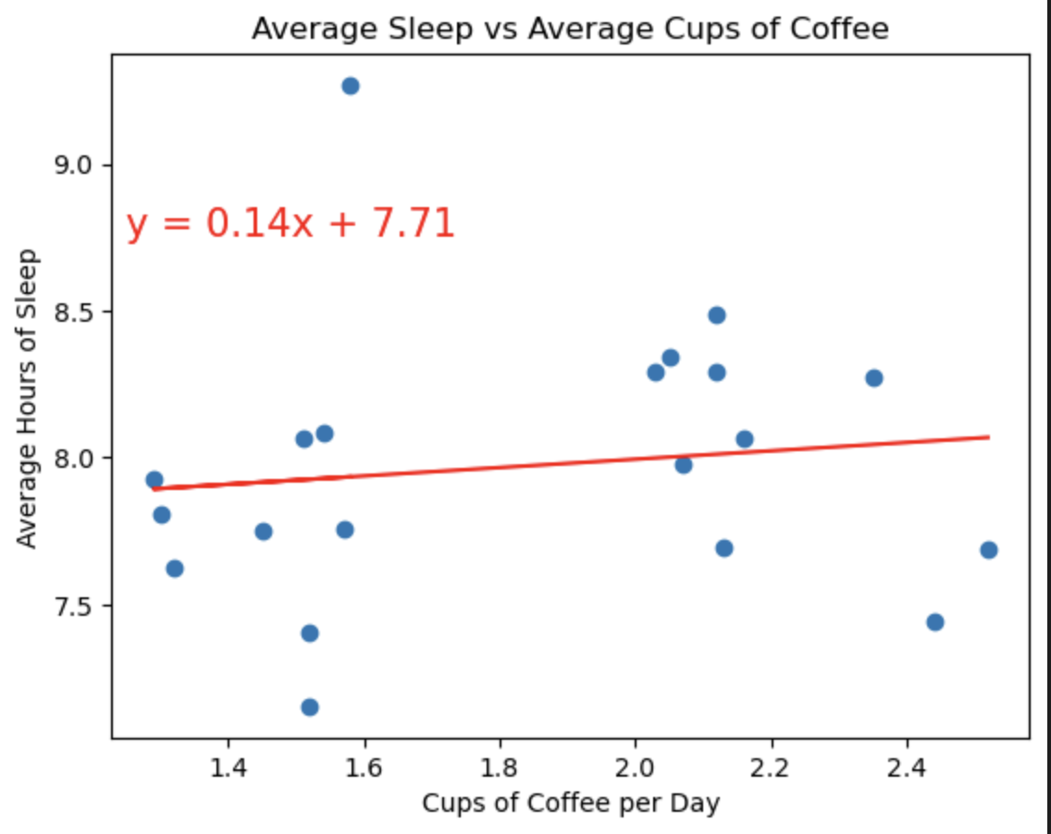
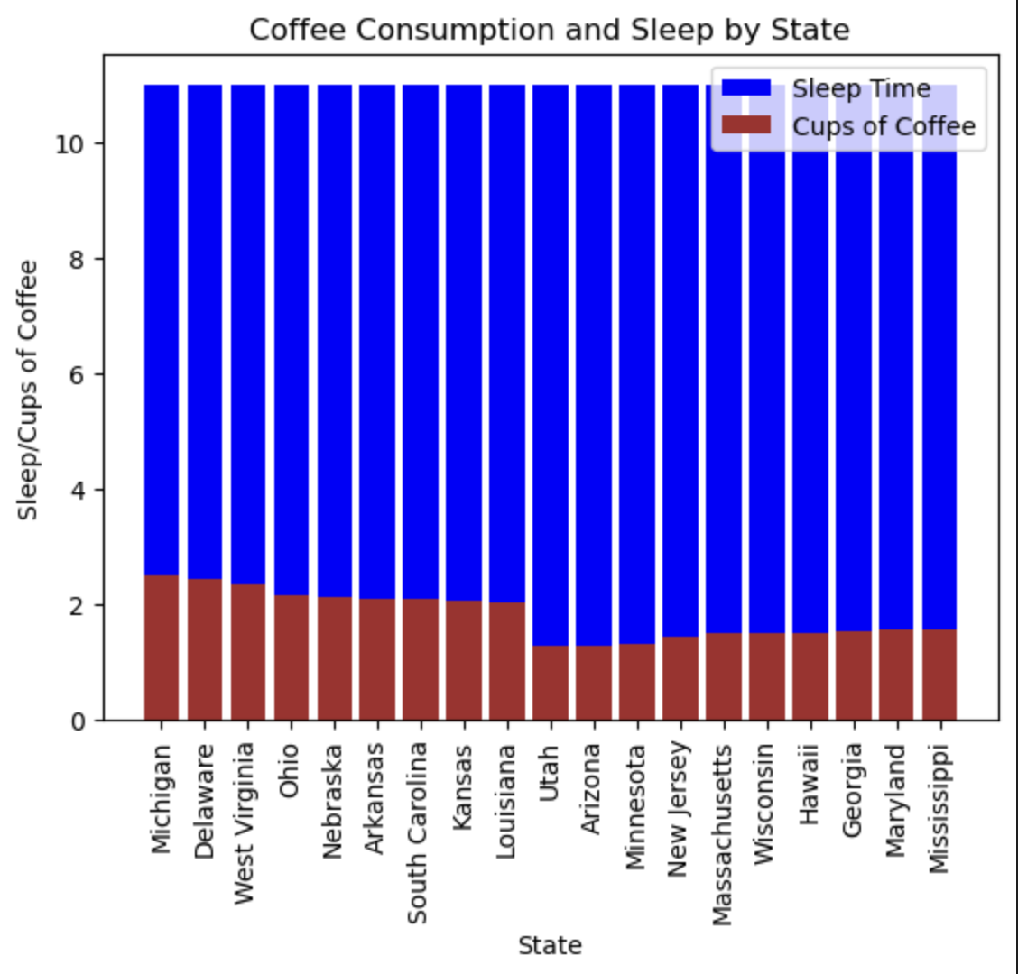
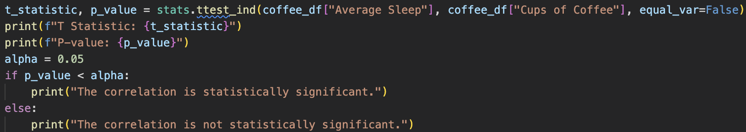
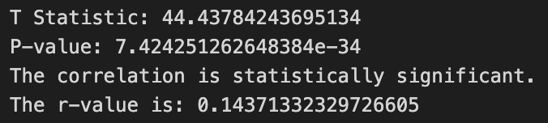
What is the correlation between coffee consumption rates and insomnia?
The p value (7.424251262648384e-34) is very small and suggests strong evidence against the null hypothesis.
This means the observed result is highly unlikely to occur by chance, which supports the rejection of the null hypothesis.
The r value of about 0.14 suggests a very weak positive linear correlation.
Overall the t statistic and p value together suggest that the result is significant, that it is unlikely due to random chance, and we may reject the null hypothesis
the r value suggest a positive, but very weak trend in the data.

Slide 4

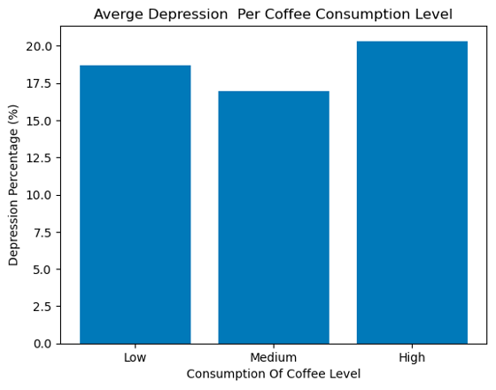
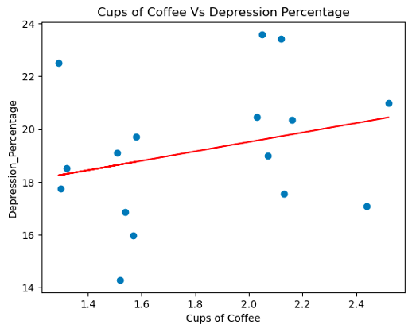
Is there a Relation between Coffee Consumption & Depression Percentage?
The bar plot presents the mean depression percentages across three categories of coffee consumption: Low, Medium, and High.
The correlation between cups of coffee and the depression percentage is 0.28.

Slide 5
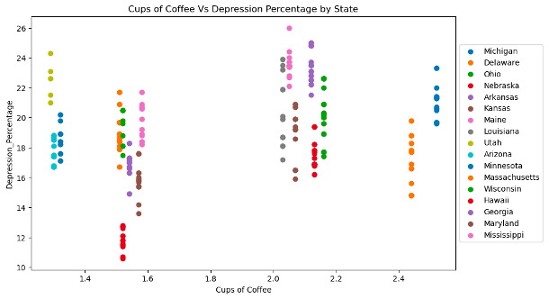
Relation Between Coffee consumption & Depression Percentage by State

Slide 6
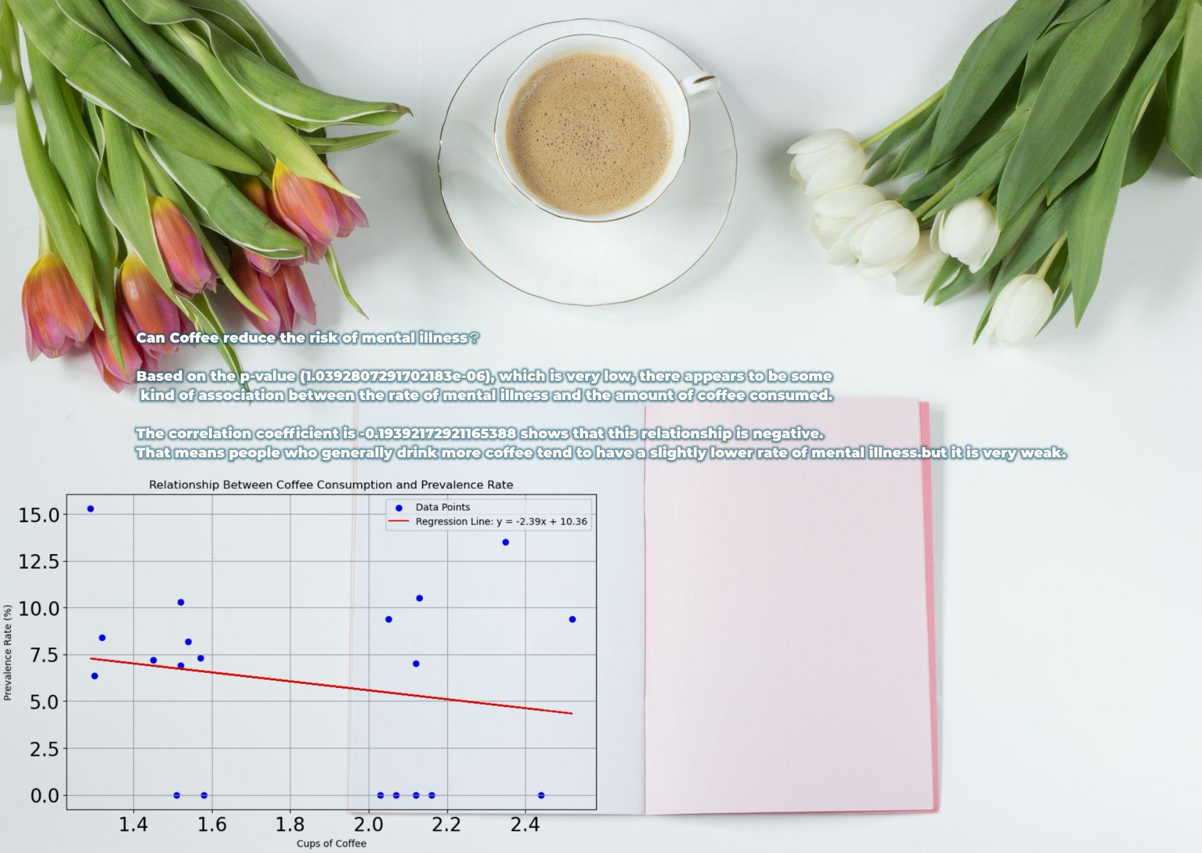
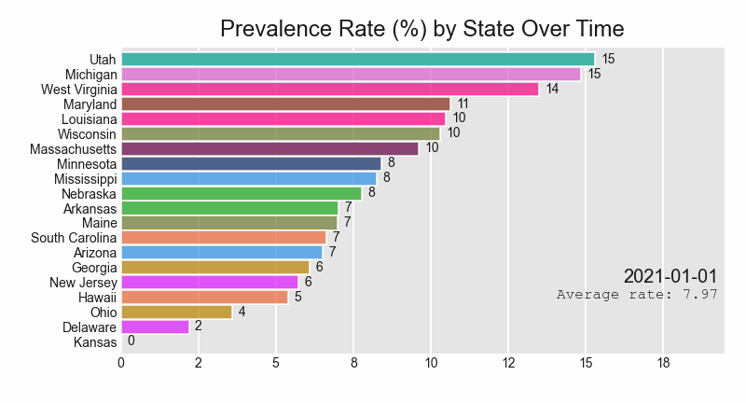
Site and mental health

Slide 7

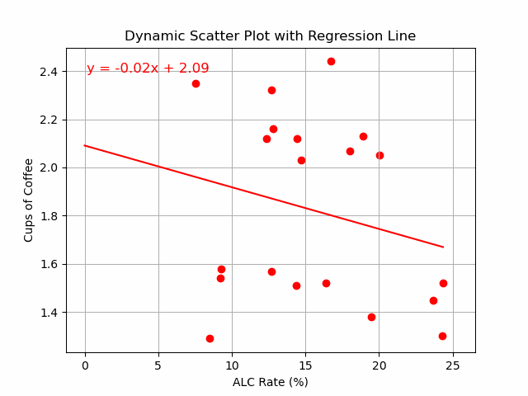
Site and alcohol

Slide 8

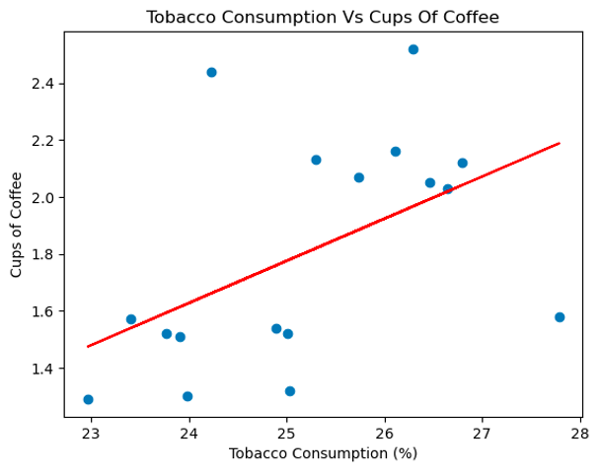
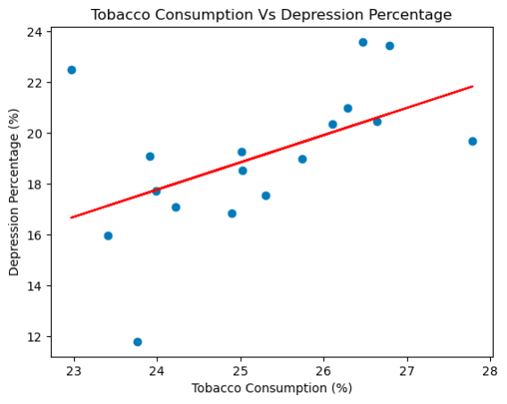
Tobacco Consumption, Coffee Intake, and Depression Rates
The correlation coefficient between Tobacco consumption and depression percentage is 0.50, indicating a moderate positive correlation.
The coefficient is 0.50, which indicates a moderate positive correlation. This means that, generally, as tobacco consumption increases, coffee consumption also tends to increase in the states observed.

Slide 9
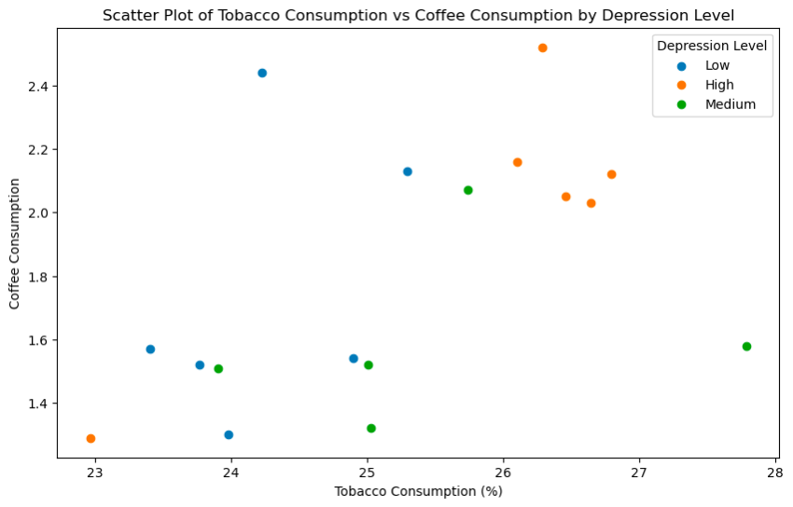
Tobacco and Coffee Consumption Patterns Categorized by Depression Levels

Slide 10

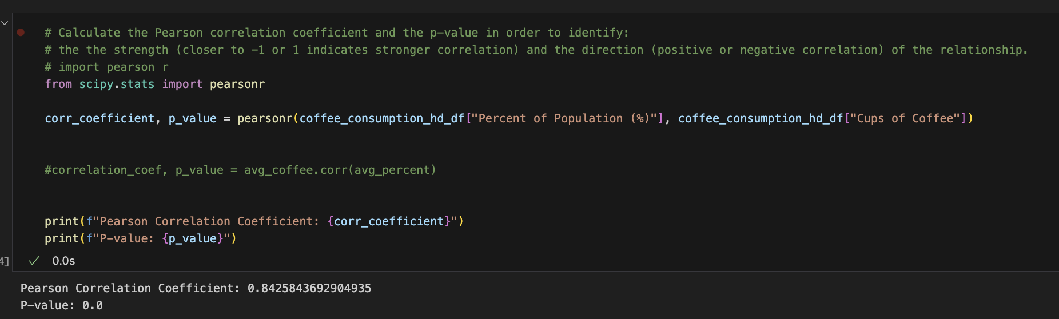
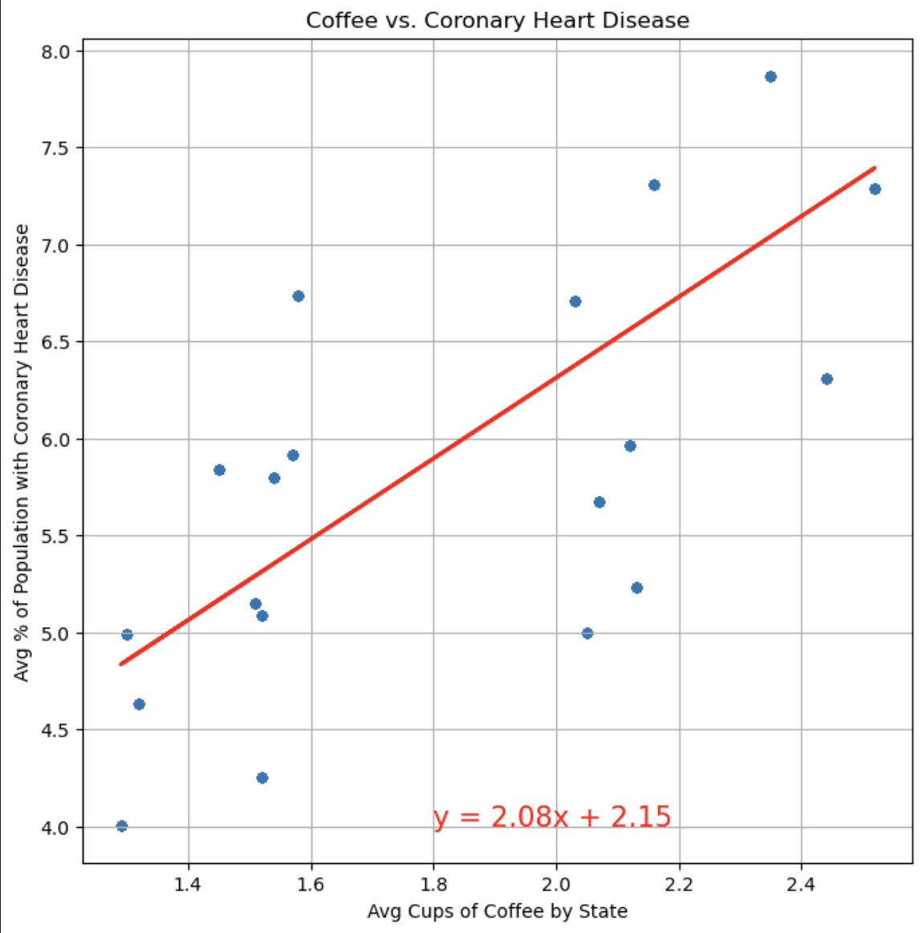
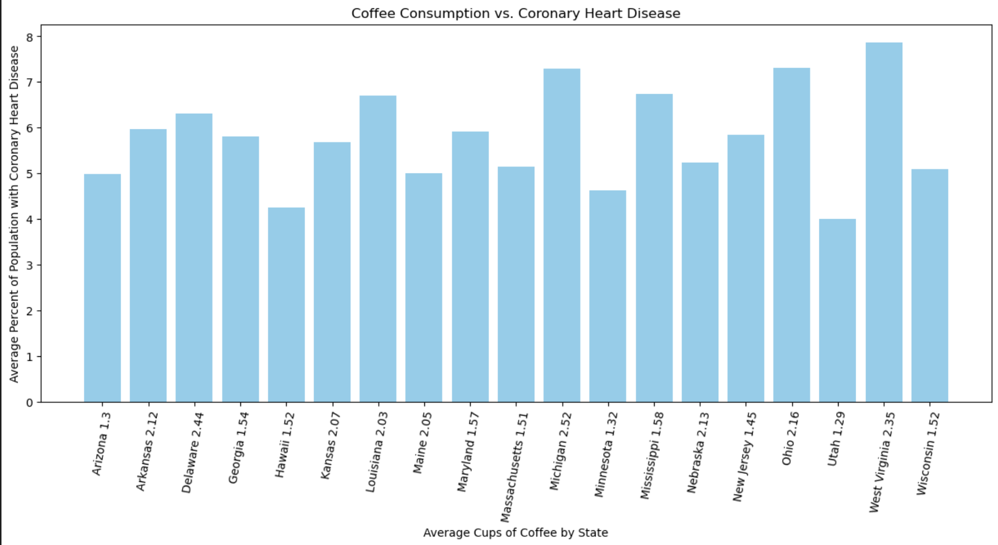
Does coffee consumption increase the risk of coronary heart disease?
The Pearson correlation coefficient of 0.8426, suggesting a strong positive linear relationship between coffee consumption and coronary heart disease.
A p-value of 0 indicates that you can reject the null hypothesis because there is a significant correlation between the variables. In other words, the positive correlation probably did not occur by chance. We could say that the more coffee you drink, the higher the possibility of having coronary heart disease.

Slide 11

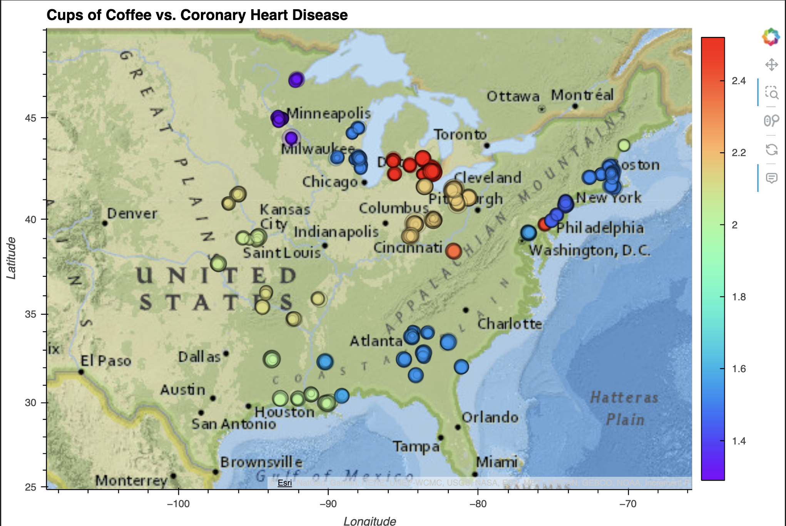
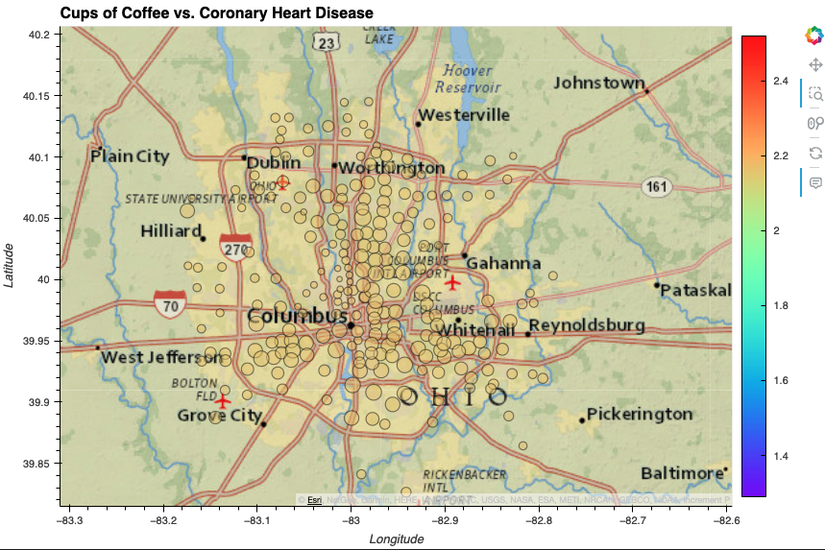

Slide 12

Reject the null hypothesis
According to our calculations, there is in fact a positive statistical significance between the amount of coffee consumed and overall health problems such as insomnia, tobacco addiction, heart disease, and mental health issues. One exception seems to be alcoholism, which cannot be proven to be related to the amount of coffee consumed. Although these calculations show a positive statistical significance between coffee consumption and overall health, there are still many other factors that contribute to the overall health levels of the observed populations that were not considered.

Slide 13

Data Sources
Main Api or Datasets:
https://data.cdc.gov
https://simpletexting.com/blog/most-coffee-obsessed-states-survey/
Specific data sources：
Mental health:
https://data.cdc.gov/Chronic-Disease-Indicators/U-S-Chronic-Disease-Indicators-Mental-Health
Alcohol use:
https://data.cdc.gov/Chronic-Disease-Indicators/U-S-Chronic-Disease-Indicators-Alcohol
Depression Rate:
https://usafacts.org/data/topics/people-society/health/health-risk-factors/depression/
Insomnia: https://www.kaggle.com/datasets/aemreusta/brfss-2020-survey-data
Coronary Heart Disease: https://data.cdc.gov/500-Cities-Places/500-Cities-Coronary-heart-disease-among-adults-age/cqcq-r6f8
Tobacco Use: https://data.cdc.gov/Survey-Data/Behavioral-Risk-Factor-Data-Tobacco-Use-2011-to-pr/wsas-xwh5

